Slide 1
Bitcoin – nuts and bolts [transactions + scripts]

Slide 2
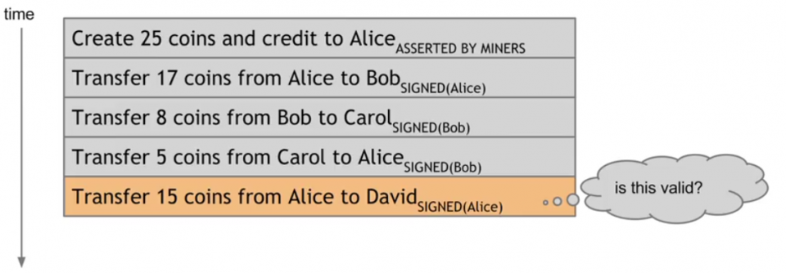
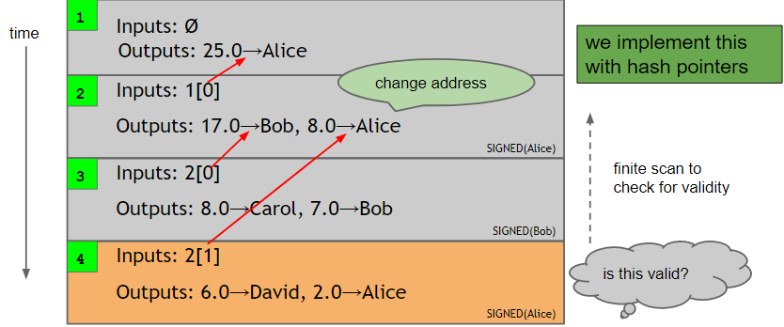
transactions
banks
account-based paradigm
housekeeping
transaction-based model
append-only ledger
inputs, outputs
change addresses
Notes:
-banks use an account-based model
-banks maintain state for every customer (what about privacy!)
-have to scan back to beginning of time
-transaction linkages not required in this case

Slide 3
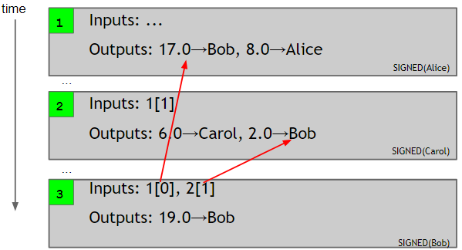
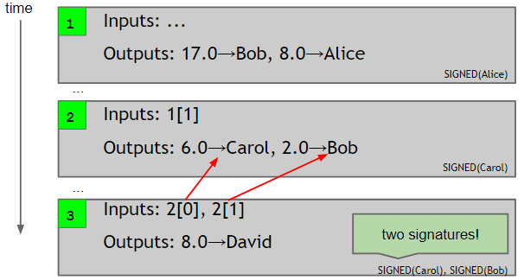
properties
efficient verification
consolidating funds
joint payments
Notes:
-efficient – one just has to check transaction outputs – easy, thanks to hash pointers
-just have to check if output has been spent on ledger – from transaction reference to current point in time – one doesn’t have to go all the way back
-one does not have to maintain state (but some state can help)
-Bob can add multiple inputs to a transaction to spend larger amounts of funds
-Alice and Bob can make a joint payment by adding two inputs – two signatures required

Slide 4
Syntax: metadata
{ "hash":"5a42590...b8b6b", "ver":1, "vin_sz":2, "vout_sz":1, "lock_time":0, "size":404,
...
}
transaction hash
housekeeping
not valid before
housekeeping
Notes:
-metadata – data about data
-hash serves as unique ID for transaction + hash pointers can be used to reference transactions
- lock_time – more on this later

Slide 5
Transaction inputs
"in":[ { "prev_out":{ "hash":"3be4...80260", "n":0 },
"scriptSig":"30440....3f3a4ce81" }, ...
],
previous
transaction
signature
(more inputs)
Notes:
-tx inputs form an array
-an input specifies a previous transaction – so it contains a hash of that transaction (unique ID!)
-also contains index value of referenced output of that transaction
-and then, of course, the signature

Slide 6
Transaction outputs
"out":[
{
"value":"10.12287097",
"scriptPubKey":"OP_DUP OP_HASH160 69e...3d42e OP_EQUALVERIFY OP_CHECKSIG"
},
...
]
more on this soon...
output value
(more outputs)
recipient address
Notes:
-outputs are also an array
-each output has two fields: value and script
-recipient address is hash of a public key
-scripts!

Slide 7
scripts
why scripts?
basic script: redeem by signature from owner of address X
X = H(public key)
redeem by public key that hashes to X, along with signature by owner of that public key
most common script
inputs also contain scripts!
combine input with earlier output script and run
scriptPubKey, scriptSig
Notes:
-why script instead of just a public key?
-X is hash of a public key – so technically we cant verify transaction using just X
-concatenate previous output with current input and run
-if it runs successfully, the transaction is valid

Slide 8
scripts
Script
Forth
simplicity
stack-based
binary outcome
no loops
256 instructions (one byte each)
if/then
logic/data handling
crypto support
Notes:
-stack-based – every instruction is executed once, in linear fashion
-no infinite loops! This is by design. Deterministic (upper bound on running time and memory usage)
-not Turing-complete – cannot compute more powerful functions (https://pics.me.me/thus-for-any-nondeterministic-turing-machine-m-that-runs-in-19869743.png)
-script is either successful (i.e. tx is valid) or not (tx is invalid)
-256 instructions (15 are disabled, 75 are reserved)
-there are some words which existed in very early versions of Bitcoin but were removed out of concern that the client might have a bug in their implementation. This fear was motivated by a bug found in OP_LSHIFT that could crash any Bitcoin node if exploited and by other bugs that allowed anyone to spend anyone's bitcoins. The removed opcodes are sometimes said to be "disabled", but this is something of a misnomer because there is absolutely no way for anyone using Bitcoin to use these opcodes (they simply do not exist anymore in the protocol), and there are also no solid plans to ever re-enable all of these opcodes. They are listed here for historical interest only.

Slide 9
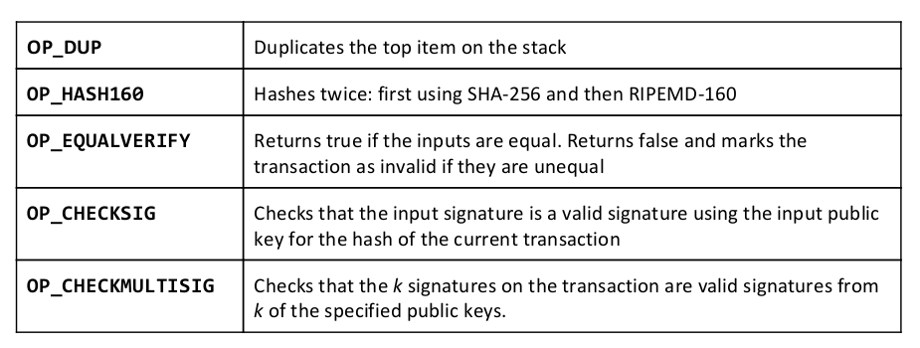

Common instructions
bug: extra data value popped from stack, ignored
Notes:
-RIPEMD was used because it produces the shortest hashes whose uniqueness is still sufficiently assured. This allows Bitcoin addresses to be shorter.
-SHA256 is used as well because Bitcoin's use of a hash of a public key might create unique weaknesses due to unexpected interactions between RIPEMD and ECDSA (the public key signature algorithm). Interposing an additional and very different hash operation between RIPEMD and ECDSA makes it almost inconceivable that there might be a way to find address collisions that is significantly easier than brute force trying a large number of secret keys.
Essentially, it was a belt and suspenders approach. Bitcoin had to do something unique and rather than have to hope they got it exactly right, they overdesigned it.
-bug was in original implementation – too expensive to fix
This is just a quirk of the Bitcoin language, and one has to deal with it by putting an extra dummy variable
onto the stack. The bug was in the original implementation, and the costs of fixing it are much higher than the damage it causes

Slide 10
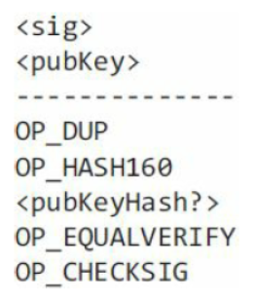
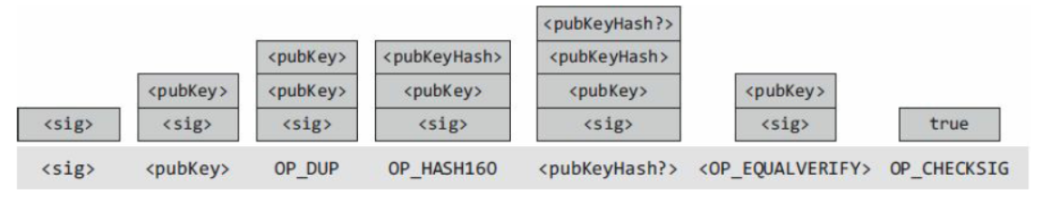
execution
stack
no memory or variables
data instructions, opcodes
Notes:
-opcode = operation code
-data instruction – simply pushes data to top of stack (with angle brackets)
-opcode – performs actual function, often using input data from top of stack (OP_ prefix)
-concatenate two scripts (input and output)
-first two instructions – push data onto stack
-OP_DUP – duplicate topmost item on stack
-OP_HASH160 – pop topmost item, hash it, and put back on top of stack
-push pubKeyHash value on top of stack (this was specified by sender – fingerprint of public key that can be used to redeem the transaction) – so top values right now on stack are: 1) hash of public key specified by sender, and 2) hash of public key used by recipient to claim coins
-OP_EQUALVERIFY – confirms that both are equal – both items consumed
-OP_CHECKSIG – verifies is signature is accurate
-why does CHECKSIG come after public key verification? – because its common sense

Slide 11

humor

Slide 12
Homework
Chap 3: Bitcoin Mechanics Bitcoin and Cryptocurrency Technologies: A Comprehensive Introduction
Bitcoins the hard way (link)
Scripts (link)

